Slide 1
Virtual Private Networks (VPN)

Slide 2
Virtual Private Networks (VPN)
A VPN is a mechanism of employing encryption, authentication and integrity protection so that we can use a public network (such as the Internet) as if it is a private network (such as a physical network created and controlled by an organization).
A VPN is thus a mechanism to simulate a private network over a public network.

Slide 3
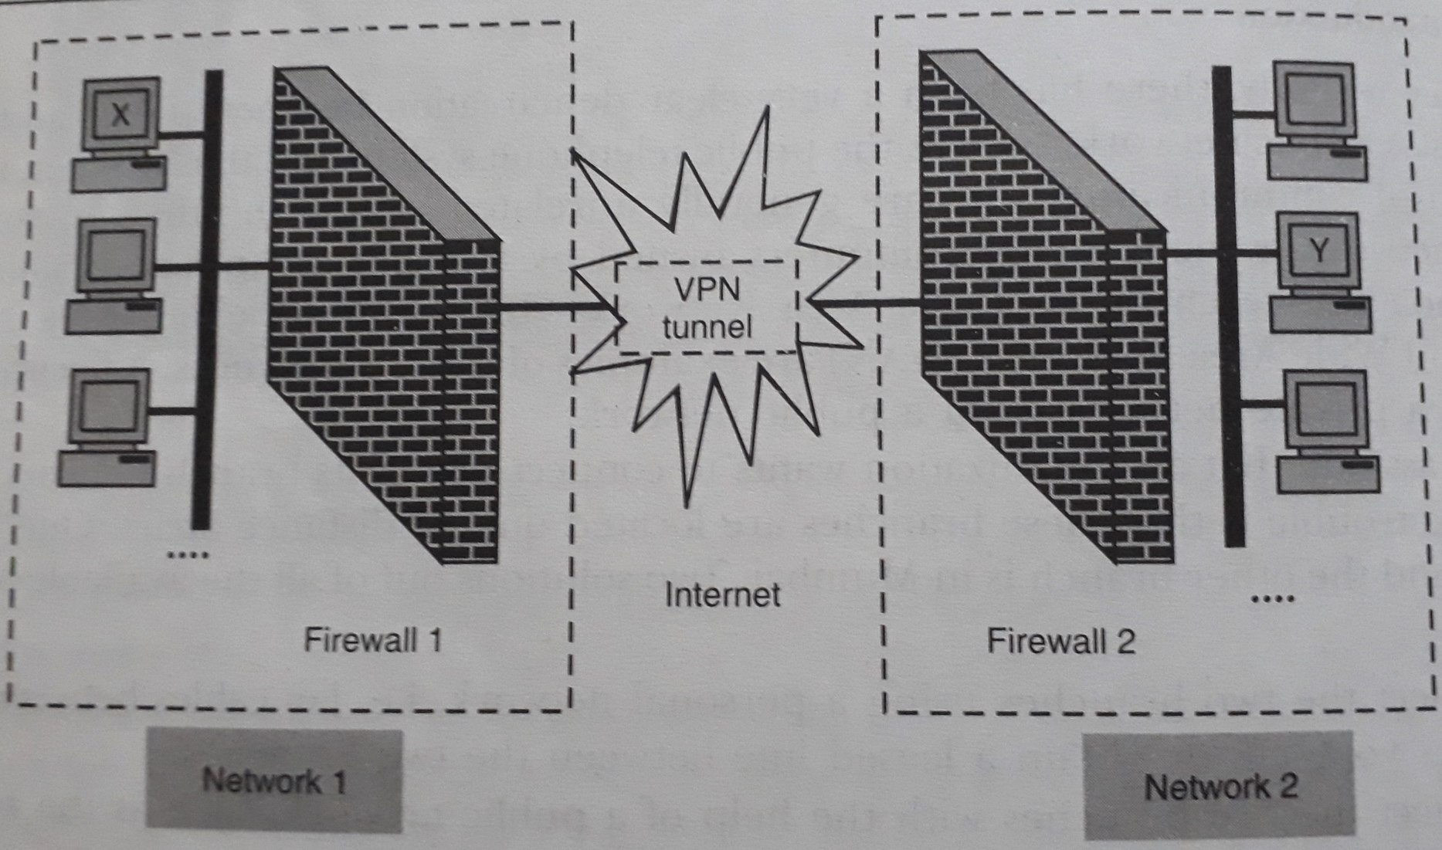
VPN Architecture

Slide 4
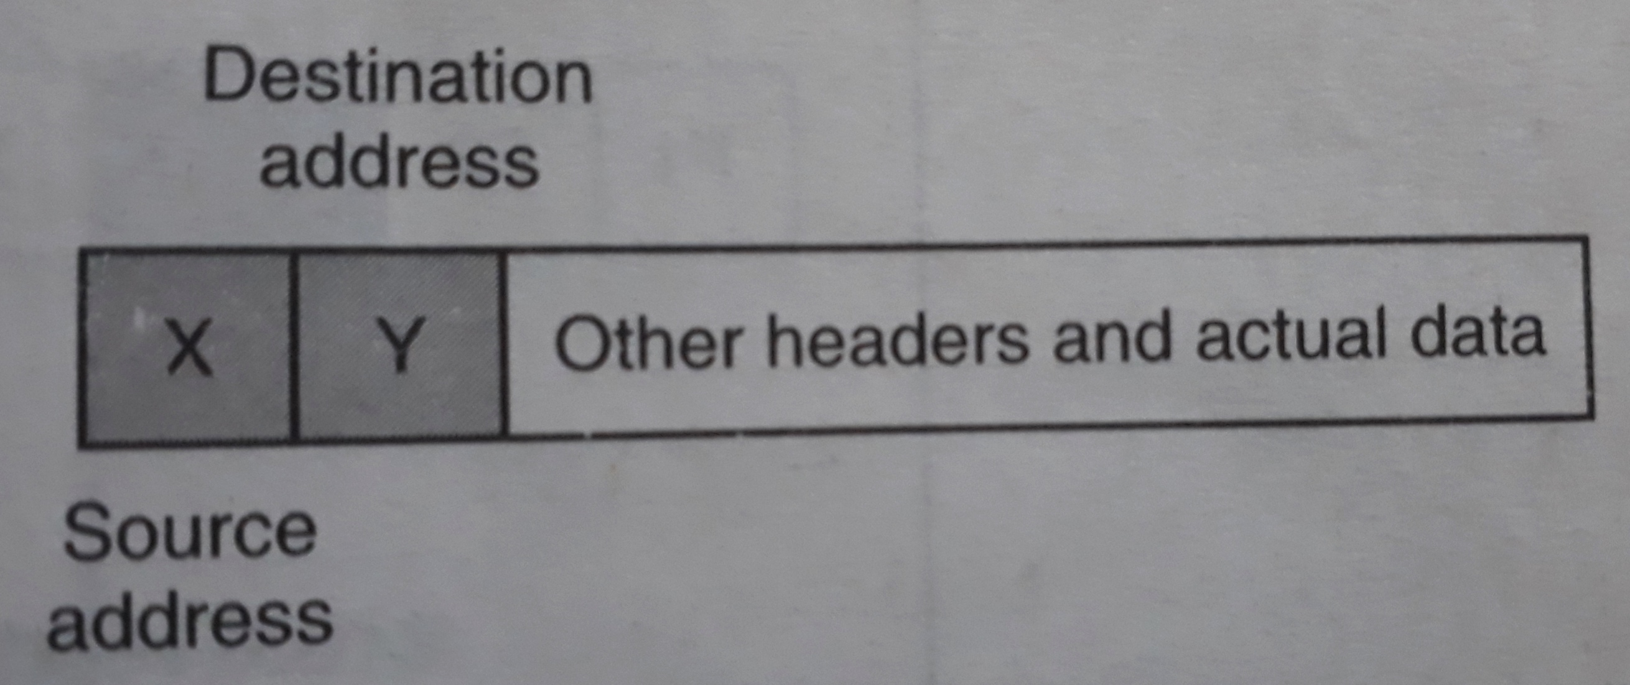
Working of VPN (1/3) Sender creates the original packet

Slide 5
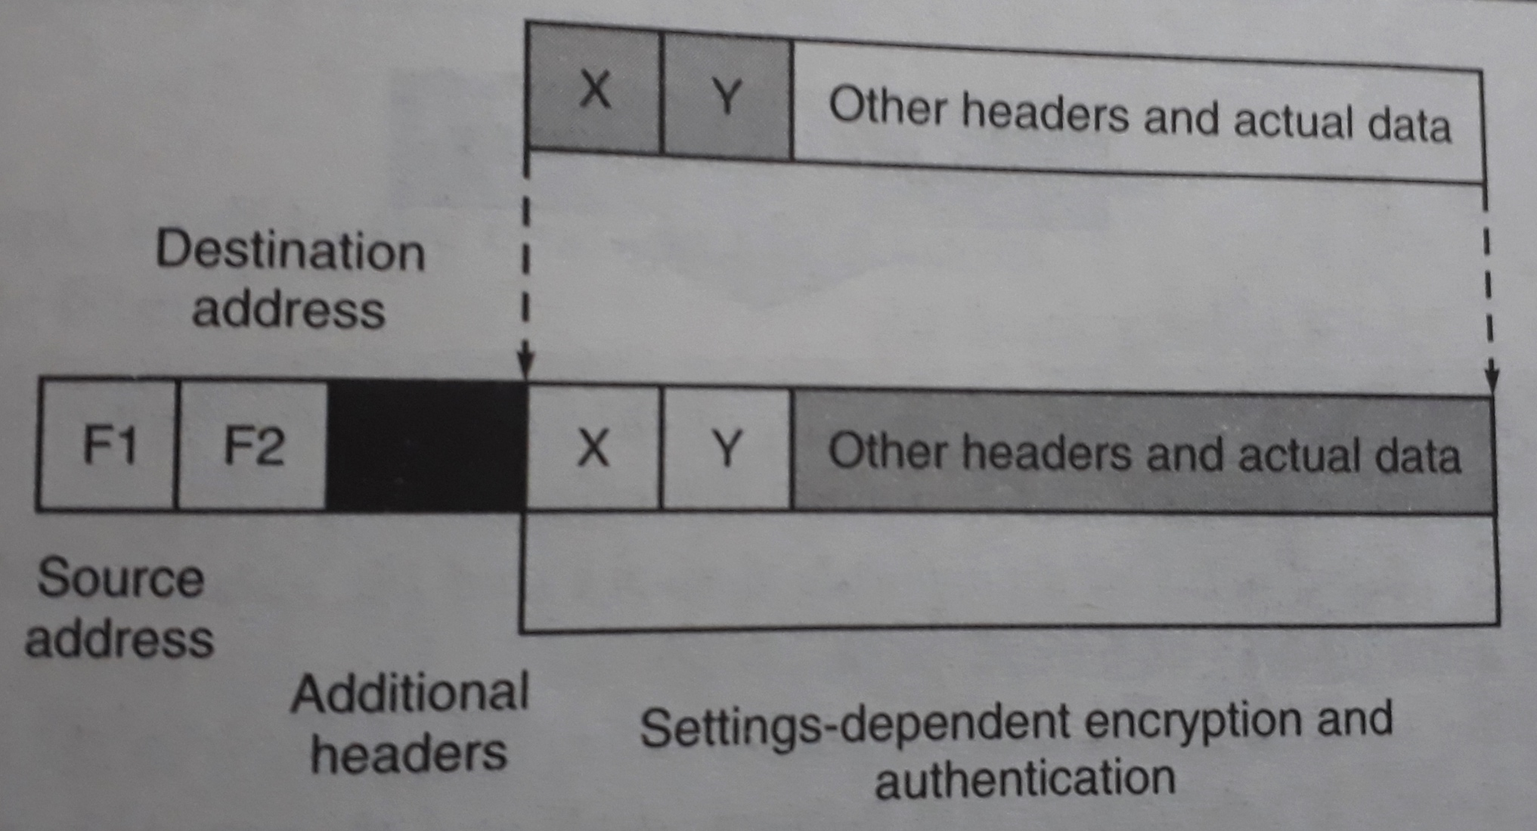
Working of VPN (2/3) Firewall at sender’s end changes the packet contents

Slide 6
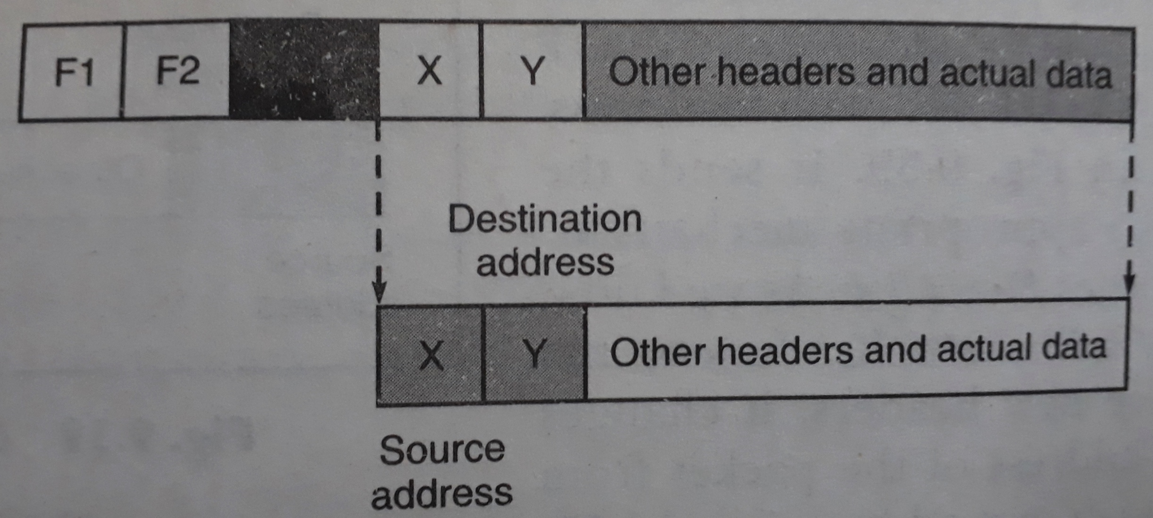
Working of VPN (2/3) Firewall at receiver’s end retrieves the original packet contents

Slide 7
THANK YOU

